Slide 1
LEGENDRE AND JACOBI SYMBOL

Slide 2
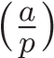
LEGENDRE SYMBOL
.
The Legendre symbol is convenient notation to indicate
whether an integer a is a quadratic residue modulo an odd prime p.
The Legendre symbol of a modulo p is denoted by

Slide 3
Definition of Legendre Symbol
Let p be an odd prime .We define
1 if a is a non-zero quadratic residue modulo p
-1 if a is a non-zero quadratic non-residue modulo p
0 if p|a

Slide 4
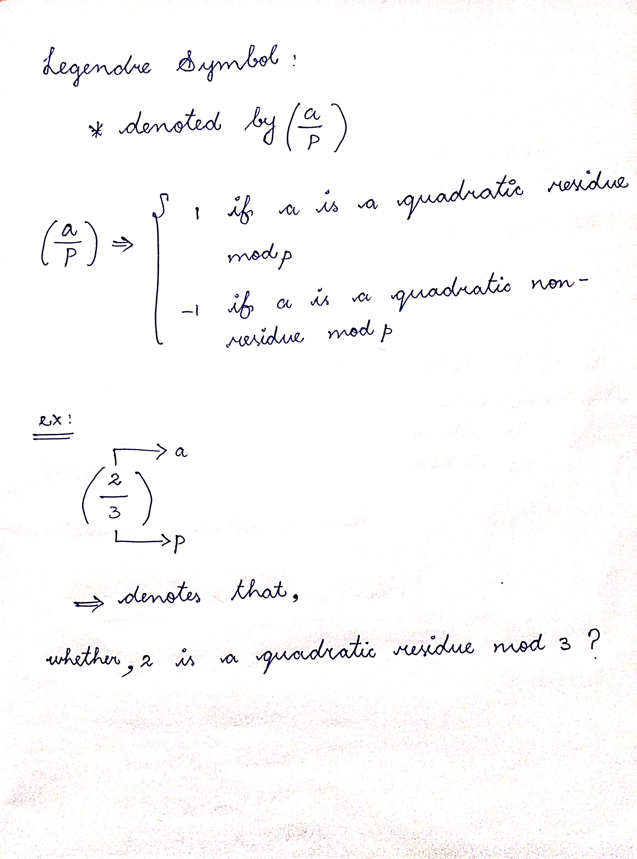

Slide 5
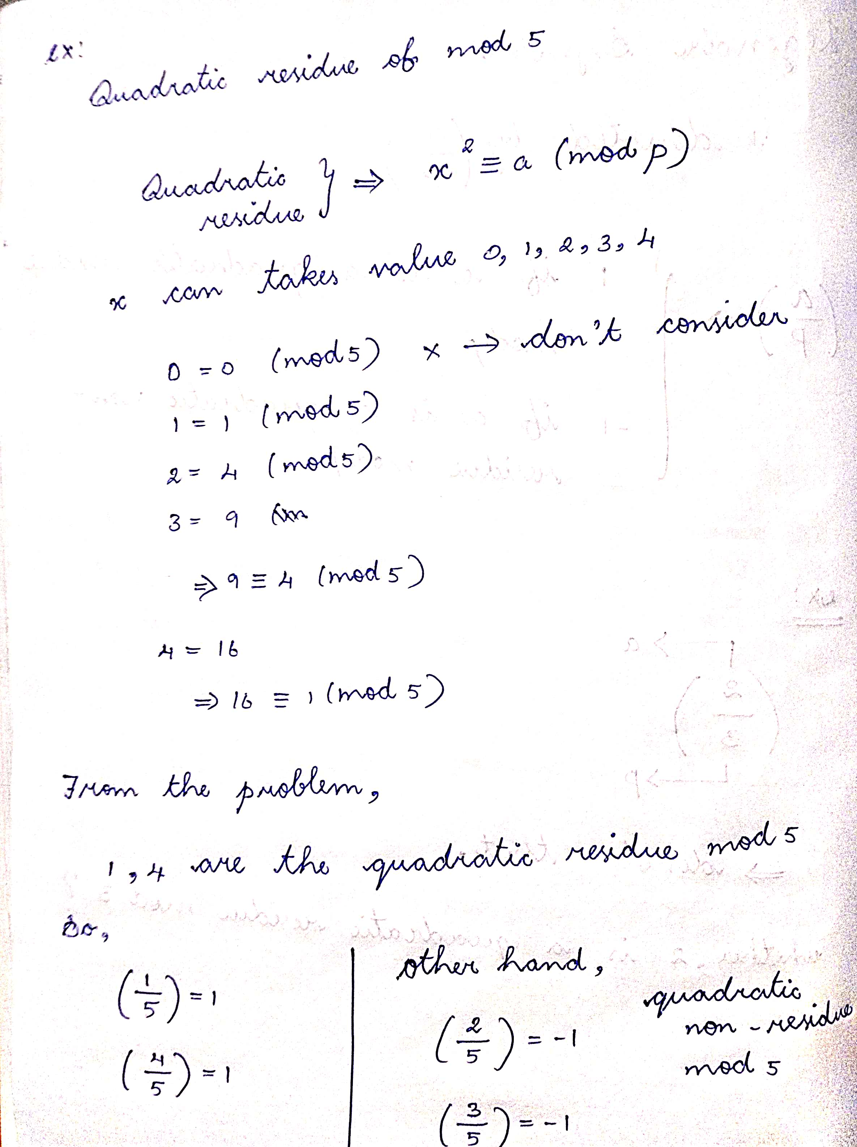

Slide 6
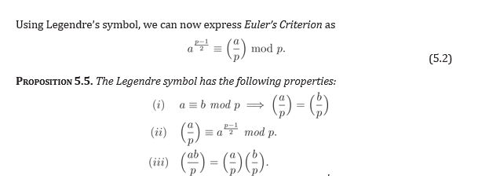

Slide 7
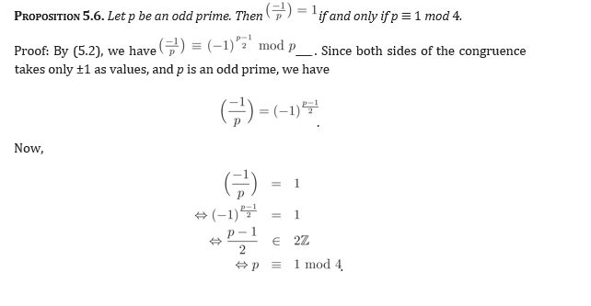

Slide 8
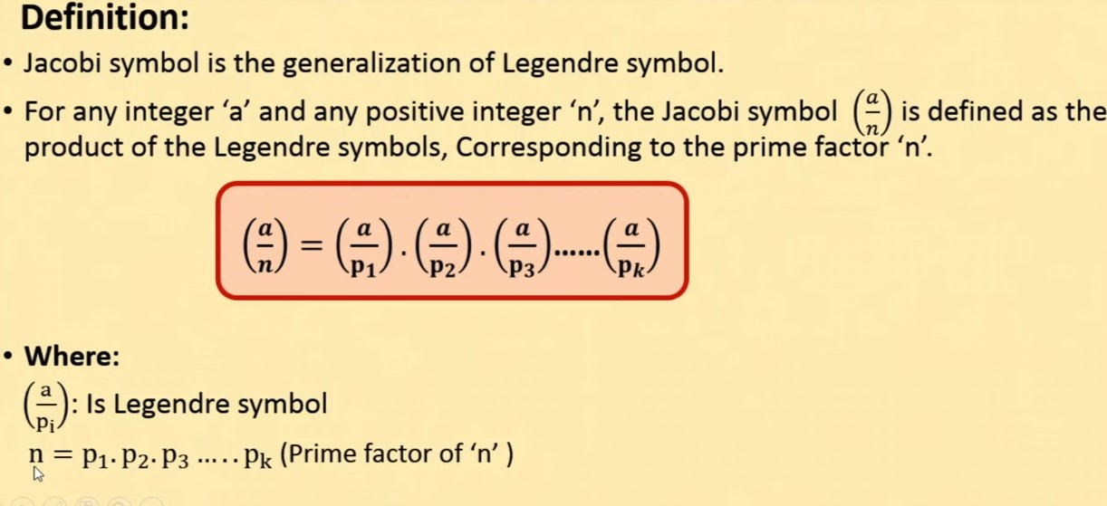

JACOBI SYMBOL

Slide 9
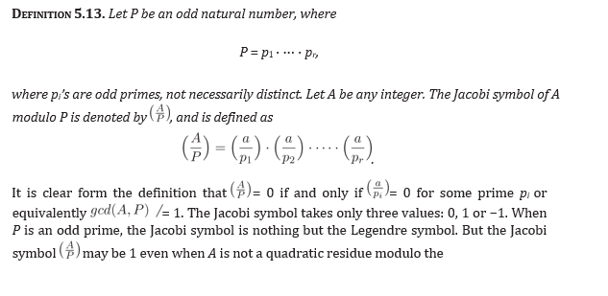
For Example,
However, note that 2 is not a quadratic residue of 15

Slide 10
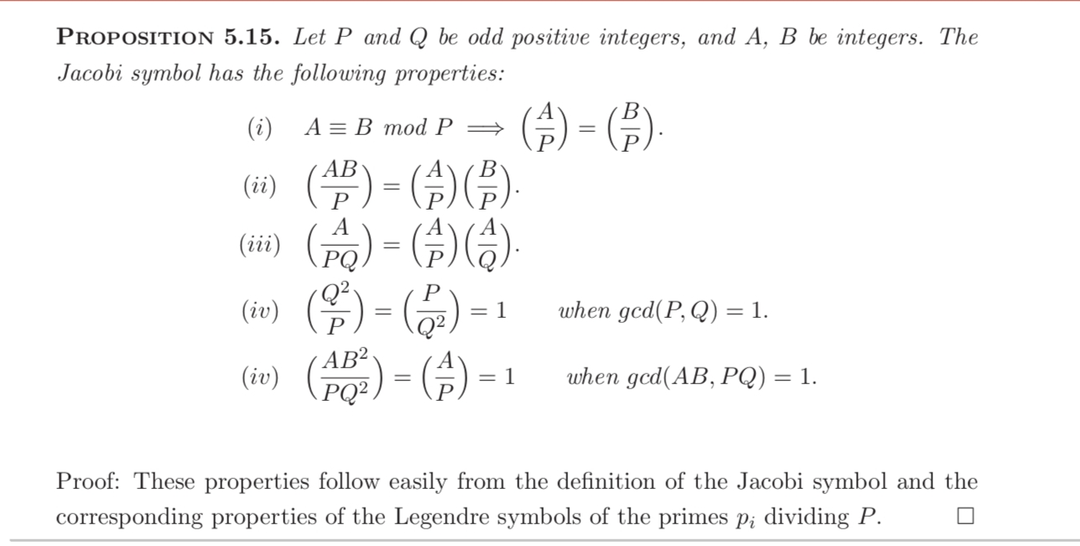

Slide 11
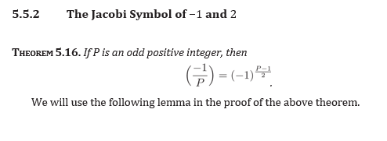
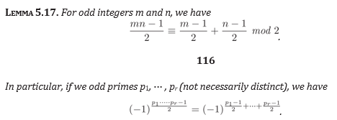

Slide 12
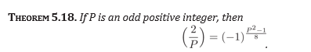

Slide 13
